Slide 1
DATA-DRIVEN FRAMEWORK
Name - Sourabh Chakroborty
Email ID – Sourabhc@ideliver-inc.com

Slide 2
OVERVIEW
Software framework
Data driven framework
Component of data driven framework
Flowchart
Business process of train booking
Business process of flight booking

Slide 3
SOFTWARE FRAMEWORK
Framework is a procedure for developing any software.
Software framework is use to improve the efficiency of creating new software. Frameworks can also improve developer productivity and improve the quality, reliability of new software.
There are 6 types of framework
→ Data driven framework

Slide 4
DATA DRIVEN FRAMEWORK
In this framework, your data is kept separate from the code, preferably in excel files or data table. This helps you execute the same code for multiple sets of data.
It can read from Excel or Data table.
So, if we run your test with different set of input data to ensure that the application works as expected for various input values. This testing approach is called data-driven testing.
Data-driven testing is creation of test scripts where test data are read from data files instead of using the same hard-coded values each time the test runs.

Slide 5
COMPONENT OF DATA DRIVEN FRAMEWORK
Data table for take input.
Excel sheet for storing status report.
Object Repository store the object use in the test.

Slide 6
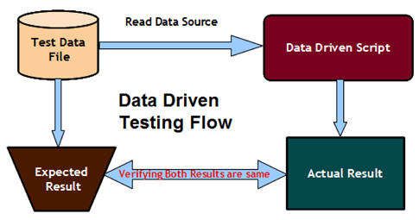
DATA DRIVEN TESTING FLOWCHART

Slide 7
BUSINESS PROCESS OF TRAIN BOOKING
BP-01: Go to http://www.makemytrip.com
BP-02: Click on "Train"
BP-03: Click on From and Type "Departure City".
BP-04: Click on To and Type "Destination City" .
BP-05: Click on Departure date Select "Given date".
BP-06: Select class "Second AC".
BP-07: Click on "Search Train"
BP-08: Book the First Train.
BP-09: Select Number of Adult Passenger "1".
BP-10: Click on "Continue".
BP-11: Fill the passenger details Name , Gender , age and country were he/she belong.
BP-12: Type Email address.
BP-13: Type Mobile number.
BP-14: Type IRCTC Username.
BP-15: Click on "Submit".

Slide 8
BUSINESS PROCESS OF FLIGHT BOOKING
BP-01: Go to http://www.makemytrip.com
BP-02: Click on "Domestic"
BP-03: Select "ONE WAY".
BP-04: Click on From and Type "Departure City".
BP-05: Click on To and Type "Destination City" .
BP-06: Click on Departure date Select “Given date".
BP-07: Select class "Business".
BP-08: Select Number of Adult Passenger "2".
BP-09: Click on "Search Flight"
BP-10: Book the First Flight.
BP-11: Type Email address.
BP-12: Check I agree option.
BP-13: Click on "Continue".
BP-14: Fill the passenger details First name , Last name , Gender for both the passenger.
BP-15: Type Mobile number.
BP-16: Click on "Continue To Payment".
BP-17: Select "Net banking" payment option.
BP-18: Select bank "State Bank Of India"
BP-19: Click on "Make Payment".

Slide 9
THANK YOU

